Slide 1

Graph Data Structure
Course Instructor : Al Amin
Email: alamin@uttarauniversity.edu.bd

Slide 2
Table of content
Introduction Of Graph
Difference between Tree and Graph Data Structure
Types Of Graph
Terminologies Of Graph
Graph Representation
Graph Operations
Graph Algorithms
Applications Of Graph

Slide 3
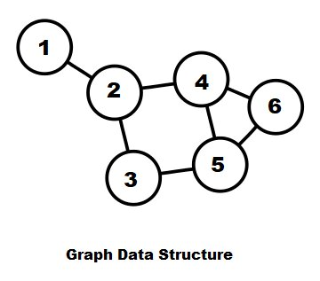
What is Graph Data Structure?
Graph is a non-linear data structure consisting of vertices and edges. The vertices are sometimes also referred to as nodes and the edges are lines that connect any two nodes in the graph. More formally a Graph is composed of a set of vertices ( V ) and a set of edges ( E ). The graph is denoted by G(V, E).

Slide 4
Difference between Tree and Graph DS
All tree are graph but all graph not tree.
Dssfdfasdfdsaf
Dsfsdfsdf
Asdffffffffffffffffffffffffffffffffffffffffffffffffffffffffffffffffffffffffffffffffffffffffffffff
asdfffffffffffffffffffffffffffffffffffffffffffffffffffffffffffffffffff

Slide 5
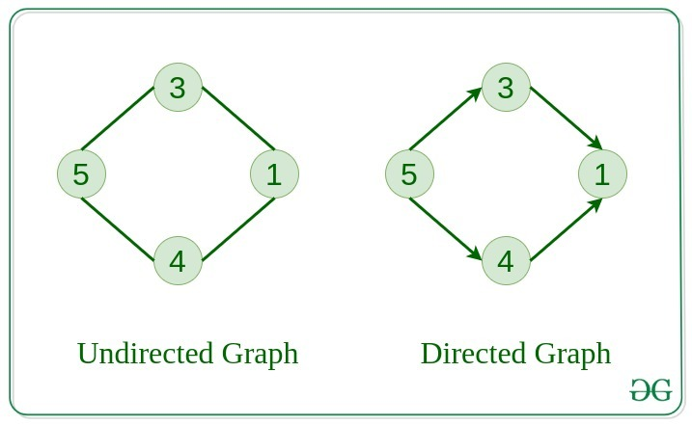
Types of Graph?
Based on direction graph is two types:
Directed Graph
Undirected Graph
Directed Graph: In this type of graph, edges have a direction. If there’s an edge from node A to B, it can only be traversed from A to B, not vice versa.
Undirected Graph: In this type of graph, edges have no direction. If there’s an edge between nodes A and B, it can be traversed in both directions.

Slide 6
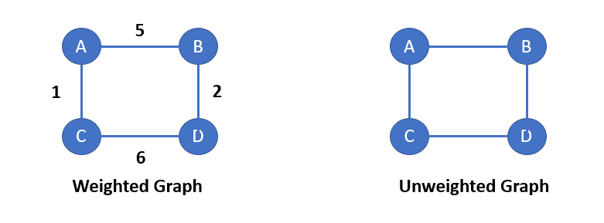
Types of Graph?
Based on weight graph is two types:
Weighted Graph
Unweighted Graph
Weighted Graph: A graph in which edges have weights or costs associated with them. Example: A road network graph where the weights can represent the distance between two cities.
Unweighted Graph: A graph in which edges have no weights or costs associated with them. Example: A social network graph where the edges represent friendships.

Slide 7
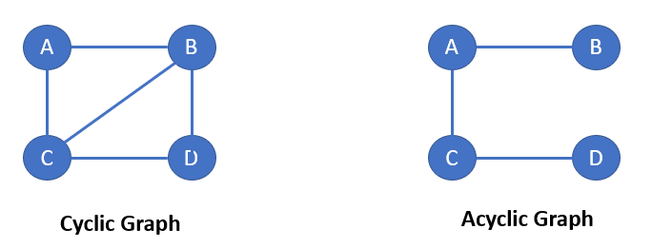
Types of Graph?
Cyclic Graph: A cyclic graph contains at least one cycle, which is a path that starts and ends at the same node.
Acyclic Graph: This type of graph has no cycles.

Slide 8
Terminologies of Graph?
Vertex (Node): An individual element in the graph.
Adjacent nodes: Node X is adjacent node Y if there is an edge from node X to node Y.
Edge: A connection between two vertices. An edge may have a weight associated with it, representing the cost or distance between vertices.
Degree: The number of edges connected to a vertex. For directed graphs, the in-degree is the number of incoming edges, and the out-degree is the number of outgoing edges.
Path: A sequence of edges that connect a series of vertices.
Cycle: A path that starts and ends at the same vertex, with all vertices and edges distinct, except the starting and ending vertex.
Connected Graph: A graph in which there is a path between every pair of vertices.

Slide 9
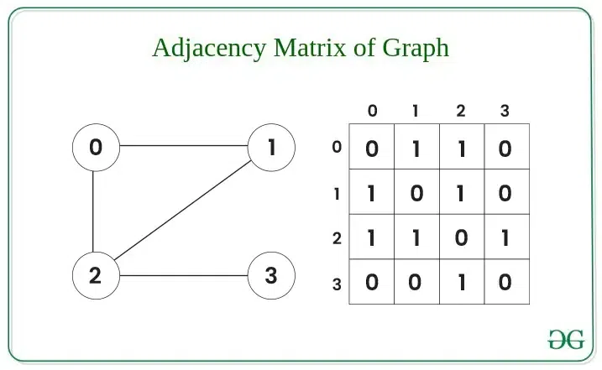
Graph Representation
Adjacency Matrix: In this method, the graph is stored in the form of the 2D matrix where rows and columns denote vertices. Each entry in the matrix represents the weight of the edge between those vertices.
If it is weighted graph, then just put the weight value instead of 1.

Slide 10
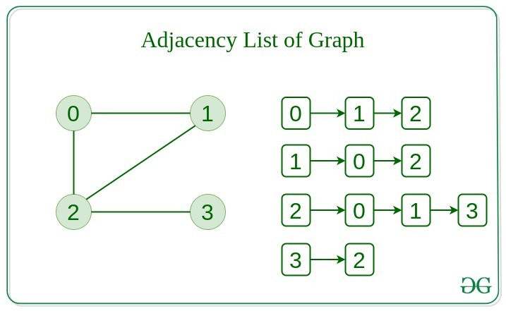
Graph Representation
Adjacency List: This graph is represented as a collection of linked lists. There is an array of pointer which points to the edges connected to that vertex.

Slide 11
Graph Operations
There are two types of graph operations:
Insertion
Deletion
Traverse

Slide 12
Graph Algorithms
Graph Traversal Algorithms:
Depth-First Search (DFS): Explores as far as possible along each branch before backtracking. Used for pathfinding, detecting cycles, and topological sorting.
Breadth-First Search (BFS): Explores all neighbors at the current depth before moving to the next level. Ideal for shortest path in unweighted graphs and connected components.
Bidirectional Search: Runs two BFS searches (from source and target) simultaneously to find the shortest path faster in large graphs.

Slide 13
Graph Algorithms
Shortest Path Algorithms:
Dijkstra’s Algorithm: Finds the shortest path from a source vertex to all other vertices in a weighted graph (non-negative weights).
Bellman-Ford Algorithm: Finds shortest paths in graphs that may have negative weights.
Floyd-Warshall Algorithm: Computes shortest paths between all pairs of vertices, typically used in dense graphs.
A* Algorithm: A heuristic-based search for shortest paths, often used in pathfinding (e.g., games, robotics) by combining actual costs and estimated costs to the goal.
Johnson’s Algorithm: Finds all-pairs shortest paths in sparse graphs with negative weights by combining Bellman-Ford and Dijkstra’s.

Slide 14
Graph Algorithms
Minimum Spanning Tree (MST): A spanning tree connects all vertices in a graph without cycles and with the minimum possible total edge weight.
Prim’s Algorithm: Builds the MST by starting from a single vertex and adding the minimum edge to grow the tree.
Kruskal’s Algorithm: Builds the MST by selecting edges in order of increasing weight, ensuring no cycles are formed.

Slide 15
Graph Algorithms
Topological Sorting: Used in directed acyclic graphs (DAGs) to order nodes such that if there’s an edge from u to v, u comes before v.
DFS-based Topological Sort: Uses DFS to produce a linear ordering of nodes.
Kahn’s Algorithm: Uses in-degree of nodes, repeatedly removing nodes with zero in-degree to build the ordering.

Slide 16
Applications of Graph
Social Networks: In platforms like Facebook, Twitter, and LinkedIn, users are represented as nodes, and their connections (friends, followers, or colleagues) as edges. Graphs are ideal for tasks like friend recommendations, finding influencers, or community detection.
Navigation and Mapping: In GPS systems and mapping applications (like Google Maps), locations are represented as nodes, and roads as edges with weights (such as distance or time). Graphs make it easy to calculate shortest paths, optimize routes, and find nearby places.
Search Engines: Graphs help represent relationships between web pages, with each page as a node and hyperlinks as directed edges. PageRank, Google's algorithm, is a graph-based algorithm that ranks pages based on their relevance.
Recommendation Systems: Graphs are used in recommendation engines (e.g., Netflix, Amazon) where users and products form nodes, and edges represent interactions (such as viewing or purchasing). Graphs help recommend similar items or suggest items based on social connections or similar tastes.
Computer Networks: Network routers and devices form a graph, with devices as nodes and connections as edges. Graphs help in routing algorithms, load balancing, and optimizing network performance.

Slide 17
References:
https://www.geeksforgeeks.org/graph-data-structure-and-algorithms/?ref=outind
https://www.javatpoint.com/types-of-graph-in-data-structure
https://www.programiz.com/dsa/spanning-tree-and-minimum-spanning-tree
https://byjus.com/maths/graph-theory/

Slide 18

Thank You

